Slide 1
Earthquakes
Geology Unit: Slides 106-123

Slide 2
Earthquakes
Definition
Shaking of the Earth’s crust due to the release of built up energy from two plates grinding against one another.

Slide 3
Causes of Earthquakes
Friction between the plates stops them from sliding past one another.
This allows energy to build up in the plates which causes them to deform.
When the plates can store no more energy the two plates snap past one another regaining their original shape, but in new positions
*Called the Elastic Rebound Theory

Slide 4
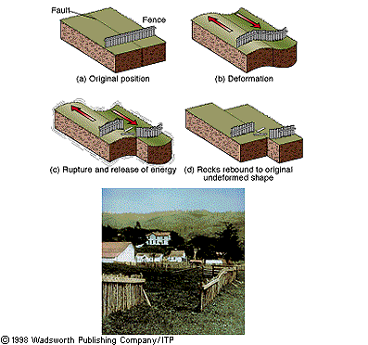

Slide 5
“Parts” of an Earthquake
Fault – Crack in the Earth’s surface where two plates meet and slide past one another. (transform boundary)
Focus – location beneath the crust along a fault where the energy between the plates was stored.
Epicenter – location on the surface directly above the focus.

Slide 6
Seismic Waves
Primary Waves (P Waves)
Fastest
Travel through solids and liquids
Waves have a compressional motion
Have the least amount of ground movement (least amount of damage)

Slide 7
Seismic Waves
Secondary Waves (S Waves)
Second fastest waves
Waves can move only through solids
Have a shearing motion

Slide 8
Seismic Waves
Surface Waves (Rayleigh Waves)
Move only along the surface
Slowest, but have the most ground movement
Cause the most damage
Motion is like that of a water wave

Slide 9
Measurement Scales
Richter Scale
Measures the amount of energy released by an earthquake.
Scale from 1 – 10
It is an exponential scale, so the amount of energy increases 10 times for each increase in number.

Slide 10
Measurement Scales
Mercalli Scale
Based on the amount of damage caused by the earthquake.
Scale from I – XII (1 – 12)

Slide 12
Earthquake Hazards
Ground Shaking
Foundation Failure (buildings collapse)
Fires (1906 – San Francisco → 80% of the city burned down)
Landslides
Tsunami – huge waves caused, generally, by underwater earthquakes

Slide 13
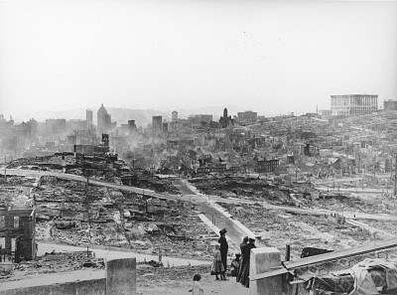
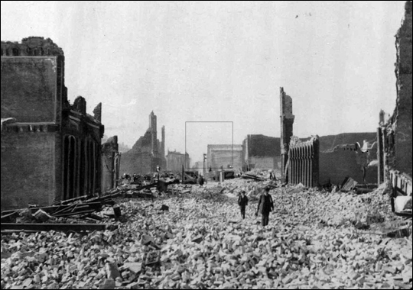

Slide 14
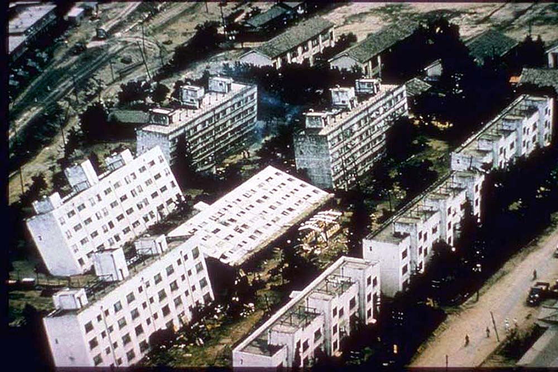

Slide 15
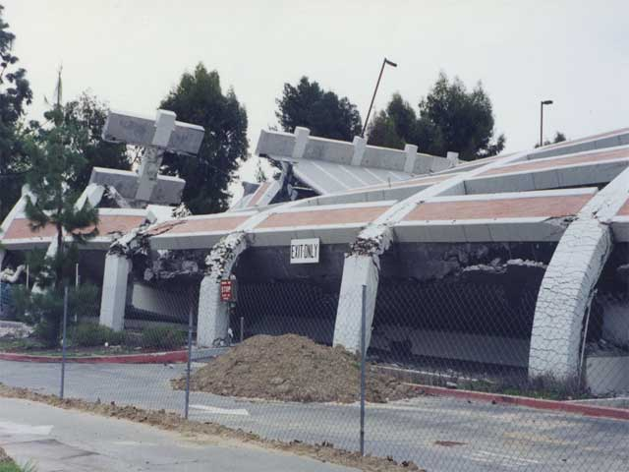

Slide 16
Instruments for Measuring Earthquake Strength
Seismograph
Instrument that measures the amount of ground movement during an earthquake.
Geologists then use the amount of ground movement to determine the strength of the earthquake. (Place it on the Richter Scale)

Slide 17
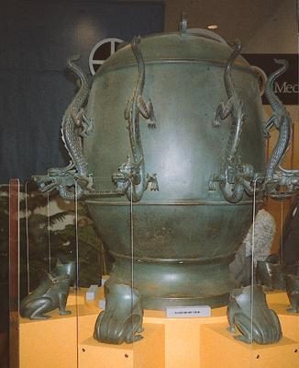

Slide 18
