Slide 1
Geology

Slide 2
Earth Basics
The Earth is Round
Support:
The North Star moved in an arc in the sky as sailors sailed north or south. (higher in the sky as they sailed north and lower in the sky as they sailed south)
The mast of a ship is the first thing you see over the horizon as it sails toward you and the last as it sails away.
The shadow of the Earth on the Moon is circular regardless of the position of the Moon.

Slide 3
Earth Basics
The Earth is NOT a sphere, it is an oblate spheroid.
The Earth bulges at the equator and flattens at the poles.
This difference in distance from the core means that you weigh slightly more at the poles than you do at the equator.

Slide 4
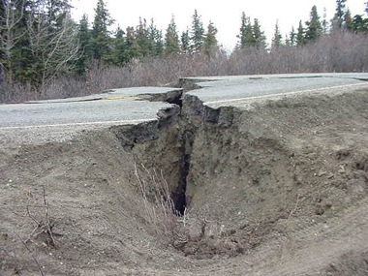
Four Classes of Geologic Events
Tectonic – caused by an earthquake

Slide 5
Four Classes of Geologic Events
Volcanic – caused by a volcanic eruption

Slide 6
Four Classes of Geologic Events
Gradational – caused by a change in grade (Slope)

Slide 7
Four Classes of Geologic Events
Impact – caused by an object colliding with the Earth

Slide 8
Basic Geology
Relative Dating – determining how old a geologic feature is compared to others.
Principle (Law) of Superposition
In any undisturbed sequence of rocks the oldest are on the bottom

Slide 9
Basic Geology
Cross-Cutting Relationships
Any object cutting through a rock layer is younger than the rock layer itself

Slide 10
Basic Geology
Impact Cratering – area that the crater is in is older than the crater itself

