Slide 1
Minerals
Geology: Slides 11-21

Slide 2
Minerals
For an object to be considered a mineral it must meet the following criteria:
It must be naturally occurring
It must be a solid
It must have a definite chemical composition
It must have a definite crystal structure
It must be inorganic (contains nothing that was ever living)

Slide 3
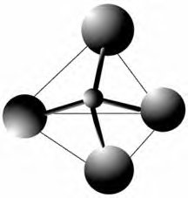
Mineral Types
1.) Silicates
90% of all minerals belong to this group
Silicon + a metal (Al, Fe, etc.)
Atoms for a silica tetrahedron
The silica tetrahedron causes the minerals to have their distinct crystal shapes.
Feldspars – most common type of silicate found in the Earth’s crust (Al has replaced some of the Si in the tetrahedron)

Slide 4
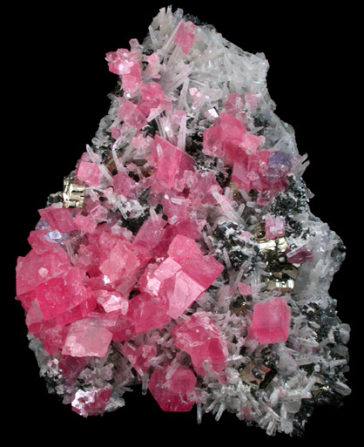
Mineral Types
2.) Carbonates
CO₃ bonded to a metal (common around here)
Generally react to acids (creating rocks that are easily dissolved by acid rain making caves and sink holes)

Slide 5
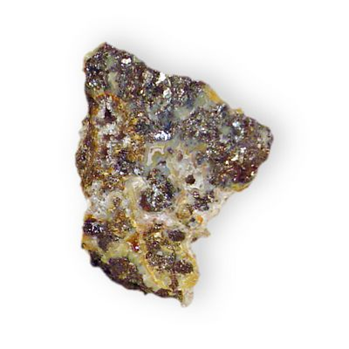
Mineral Types
3.) Iron Oxides and Iron Sulfides
Iron combined with oxygen and sulfur
Very heavy, dense minerals
Resemble a piece of metal

Slide 6
Identifying Minerals
Minerals are identified using the following properties:
(Some properties will be useful for some minerals and useless for others.)

Slide 7
Identifying Minerals
1.) Color – least useful identification property
2.) Luster – The way a mineral reflects light
(vitreous [glassy], pearly, metallic, non-metallic [earthy])
3.) Crystal Shape – atoms forming distinct crystal patterns

Slide 8
Identifying Minerals
4.) Hardness
The resistance of a mineral to being scratched
Uses the Mohs Hardness Scale
Mohs Scale ranks minerals from 1 – 10 (1 is softest and 10 is the hardest)
Talc = 1 and Diamond = 10
(not always whole numbers)

Slide 9
Identifying Minerals
5.) Streak
The color of a mineral’s powder
To obtain the mineral’s powder you rub the mineral across a Streak Plate (porcelain)
Mineral color and the mineral streak are not necessarily the same. (All minerals do not have a streak – some are too hard)

Slide 10
Identifying Minerals
6.) Cleavage and Fracture
The way in which a mineral breaks or splits
Cleavage = smooth break on a flat surface
Fracture = rough break with jagged edges

Slide 11
Identifying Minerals
7.) Specific Gravity
Ratio of the mass of a mineral compared to the mass of an equal volume of water

Slide 12
Identifying Minerals
8.) Special Properties
Taste
Odor
Sound
Radioactivity
Fluorescence
Double refraction
Reacts with acid
Magnetic

