Slide 1
Rocks
Geology: Slides 22-50

Slide 2
Rocks
Catastrophism versus Uniformitarianism
Catastrophism
The Earth’s surface was created by fast drastic changes (called catastrophes) that occurred long ago and do not occur anymore.

Slide 3
Rocks
Uniformitarianism
Developed by the father of modern Geology, James Hutton
Hutton said that the forces that made the Earth look the way it does are the still occurring today.
“The present is the key to the past”

Slide 4
What is a Rock?
A group of minerals bound together in some way (How they are bound determines the type of rock that you get.)

Slide 5
What is a Rock?
Hutton then used his idea of uniformitarianism to determine how rocks are created.
He determined that rocks are made in one of three ways…

Slide 6
1.) Igneous Rocks
Made from molten (melted) rock

Slide 7
Sedimentary Rock
Made up of pieces of other rocks

Slide 8
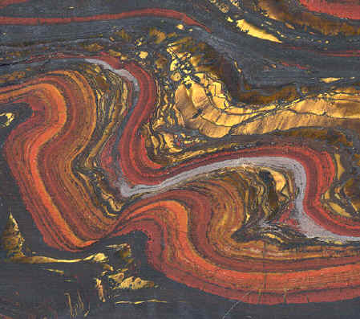
Metamorphic Rocks
Made by changes in other rocks

Slide 9
All minerals are rocks, but not all rocks are minerals. Why?
Rocks can be organic, minerals can not.
Coal and organic limestone are examples of organic rocks.

Slide 10
Igneous Rocks
Rocks that are created as magma cools and hardens.

Slide 11
Igneous Rocks
Two types of Igneous Rocks:
Intrusive – rocks cool underground
Extrusive – rocks cool above ground
Grain Size
Intrusive rocks cool more slowly so their crystals grow larger.
Extrusive rocks cool more quickly so their crystals are smaller.

Slide 12
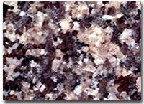
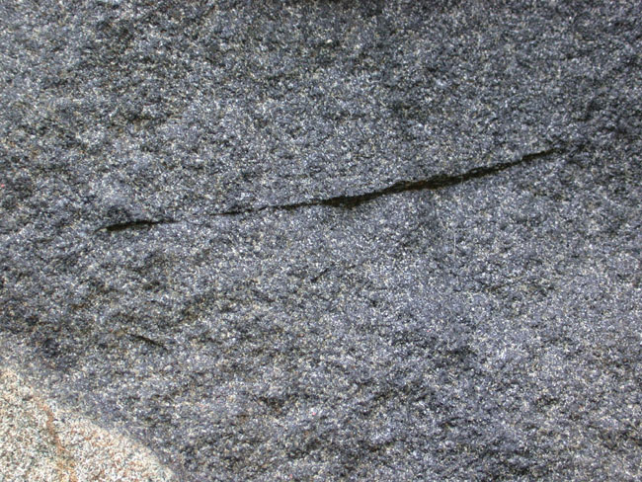
Intrusive Igneous Rock
Extrusive Igneous Rock

Slide 13
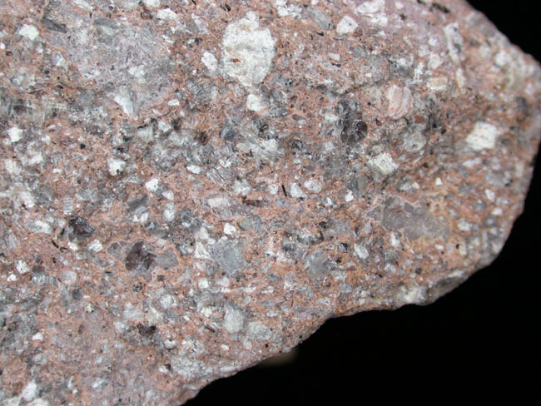
Igneous Rocks
Magma or Lava Types
Felsic – contains more than 50% silicate material (generally light colored rocks)
Mafic – contains over 50% iron and magnesium (generally dark colored rocks)

Slide 14
Igneous Rocks
Texture – based on grain size
Coarse Grained – made of large crystals Intrusive
Fine Grained – made up of small crystals
Glassy – no crystals Extrusive
Porphyritic – made up of both large Both and small crystals Int. and Ext.

Slide 15
Igneous Rocks
Describe Igneous rocks using:
Where it cooled
Type of magma or lava
Texture of the rock

Slide 17
Sedimentary Rocks
Rocks made from pieces of other rock that have become cemented together.

Slide 18
Sedimentary Rocks
There are three types of sedimentary rocks based on the way they form.

Slide 19
Types of Sedimentary Rocks
Clastic
Made by other rocks being eroded into sediments.
The sediments are then deposited and compacted.
Cement then works its way between the sediment particles and creates a rock.
Clastic rocks are described by their sorting.
Well sorted means all pieces of the rock are similar in size, poorly sorted means that the pieces that make up the rock are different sizes.

Slide 20
Types of Sedimentary Rocks
Chemical
Made as mineral rich water evaporates and the minerals are left behind.

Slide 21
Types of Sedimentary Rocks
Organic
A rock made from the remains of a dead plant or animal.
Coal (plants) and organic limestone (animal) are two examples of organic rocks.

Slide 22
Sedimentary Features
Stratification
Made as different types of sediment are layered on top of one another.
The different rock types create layers in the rocks.
It is only found in clastic sedimentary rocks.

Slide 23
Sedimentary Features
Fossils
Made from the imprint of the hard parts of plants or animals.
They are only found in clastic sedimentary rocks.

Slide 24
Sedimentary Features
Ripple Marks and Mud Cracks
Can show what the climate of an area was like during the time of the rock’s creation.
Ripple Marks are found in rocks that form near water.
Mud Cracks form in rocks from very dry, arid regions (deserts)

Slide 25
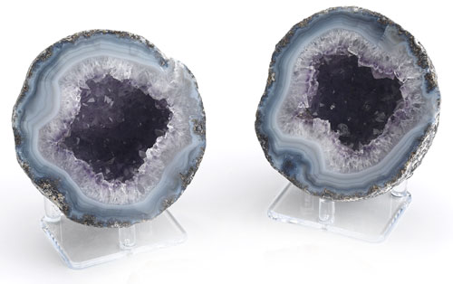
Sedimentary Features
Geodes
Forms when a rock is hollowed by mineral-rich water and then the water evaporates.
As the water evaporates it leaves the minerals behind in the form of mineral crystals within the rock.
Eventually the rocks can completely fill with mineral crystals.

Slide 26
Metamorphic Rocks
Rocks that are created by changes in the rock brought about by heat, pressure or chemical reactions.

Slide 27
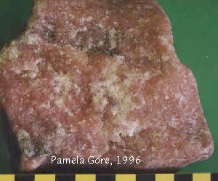
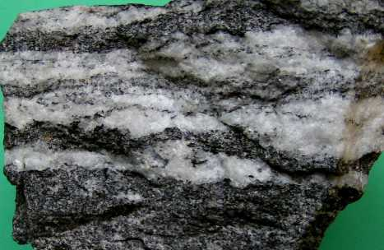
Types of Metamorphism
Contact Metamorphism
Created as lava or magma “bakes” a rock (occurs over a smaller area)
Regional Metamorphism
Created as pressure crushes a rock (occurs over a large area)

Slide 28
Metamorphic Features
Foliation
Layers within a rock created by pressure.

Slide 29
Changes in Rocks caused by Metamorphism
The growth of new minerals.
The deformation of mineral crystals.
The re-crystallization of mineral crystals as larger mineral crystals.

Slide 30
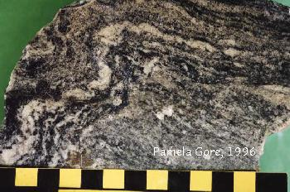
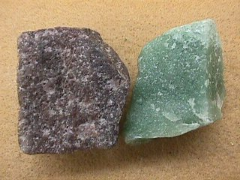
“Texture”
Foliated
Rock with layers (formed by regional metamorphism)
Non-Foliated
No layers in the rock (formed by contact metamorphism)

