Slide 1
Volcanoes
Geology Unit: Slides 72-105

Slide 2
Volcanoes
Definition – accumulation of lava and debris around a vent

Slide 3
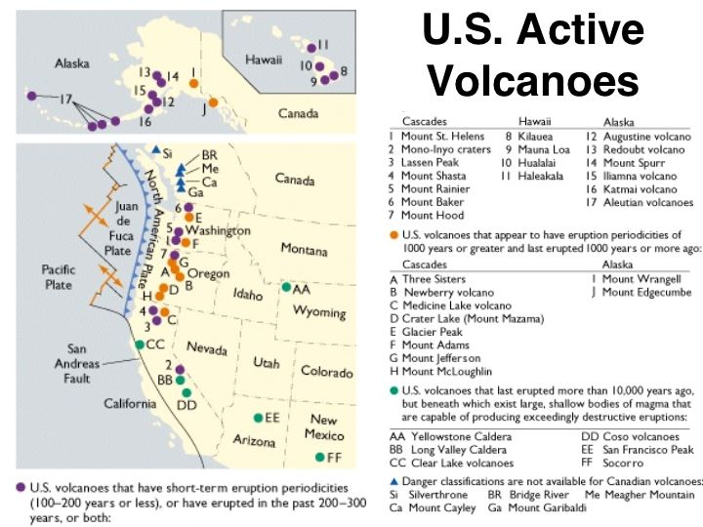

Slide 4
Volcano Types
Shield
Largest in size.
Have very gently sloping sides.
Have the most gentle (non-violent) eruptions.

Slide 6
Volcano Types
Cinder Cone
Smallest in size.
Have very steeply sloping sides.
Have medium strength eruptions (not gentle, but not the most violent)

Slide 7
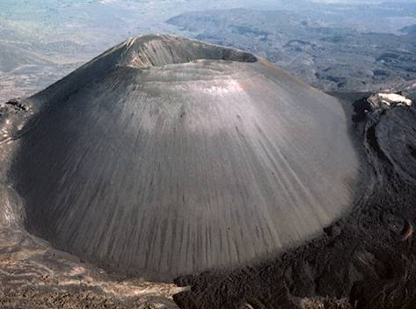

Slide 8
Volcano Types
Composite Cone
Medium-Sized (not the largest, not the smallest)
They start out sloping very gently at the base and get steeper as they reach the peak.
Their eruptions alternate between violent and gentle.

Slide 9
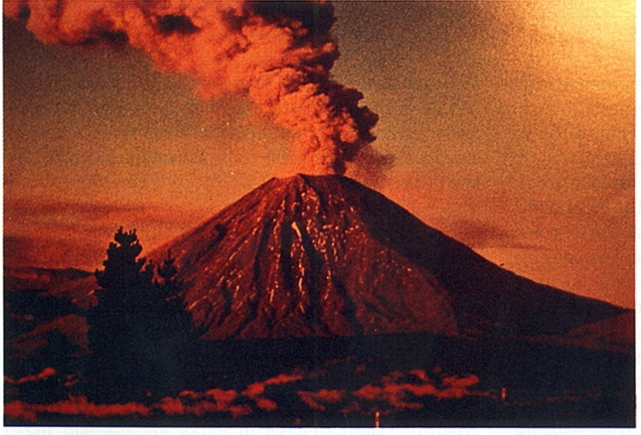

Slide 10
Volcano Formation
Volcanoes generally form at:
Divergent Boundaries – very gently erupting volcanoes
Convergent Boundaries – more violent (because of the increased pressure)
Hot Spot Volcanoes – form in the middle of a plate due to an area of the mantle that is hotter than the areas around it.

Slide 12
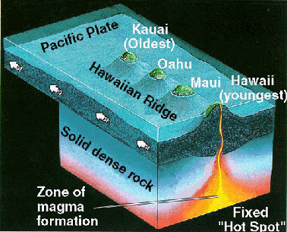

Slide 14
Volcano Features
Crater – normal, relatively small (100 - 200 m) depression at the volcanoes peak
Caldera – a very large crater (several km) that forms from erosion or explosion
Vents – areas where lava or debris escapes from the volcano
Magma Chamber – underground pockets of molten rock that feeds the volcano

Slide 15
Volcanic Eruptions
There are two factors that affect the violence of an eruption:
Magma/ Lava Composition – the more felsic the lava the more violent the eruption (felsic lava is more viscous [thicker])
Amount of Volatiles – gasses dissolved in lava
(the more gasses dissolved the more violent the eruption)

Slide 16
Volcanic Hazards
Lava Flows
Aa
Cooler, thicker lava flows
Move at around 4 mph

Slide 17
Volcanic Hazards
Lava Flows
Pahoehoe
Hotter, more liquid lava
Move at around 15 mph

Slide 18
Volcanic Hazards
Lava Flows
Base Surge
Explosion that occurs when lava contacts groundwater and generates underground pockets of superheated steam.

Slide 19
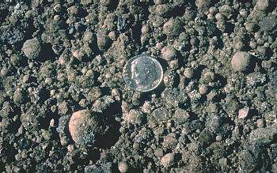
Volcanic Hazards
Tephra (any debris that comes from a volcano)
Lapilli – pebbles, no more than several cm in diameter (100 – 200ºC)
Bombs – football sized pieces of rock (travel very fast, 300 – 600ºC)
Ash – the most damaging form of tephra (due to the areas that is covers and the weight of it as it builds up on buildings)

Slide 21
Volcanic Hazards
Pyroclastic Flows (Nuee Ardantees)
An avalanche of superheated gas and rock made as hotter, more dense lava erupts from the volcano.

Slide 22
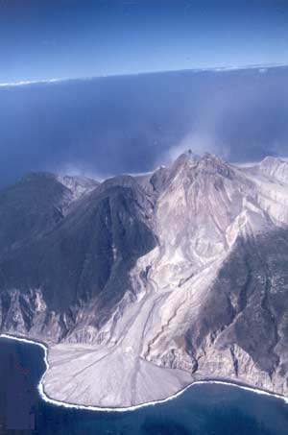

Slide 23
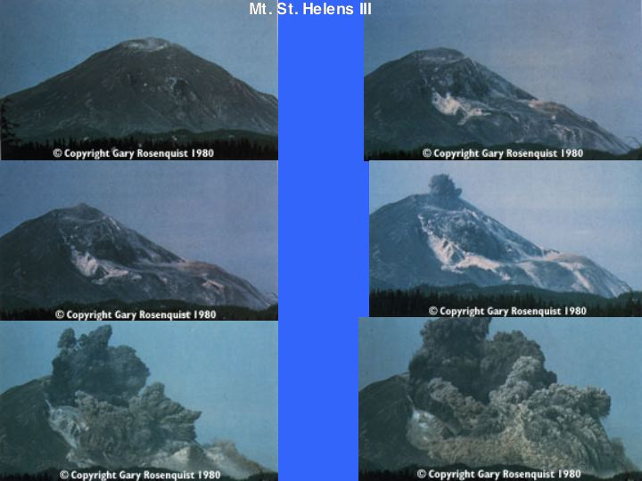

Slide 24
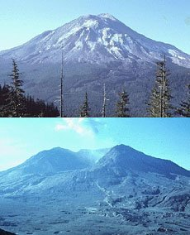

Slide 25
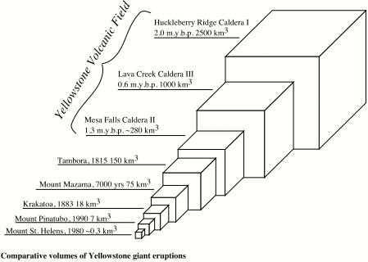

Slide 26
Volcanic Hazards
Lahars
Dense, rapid mudflows created as water mixes with ash from the volcano
The water generally comes from rain or melted snow from the peak of the volcano.

Slide 27
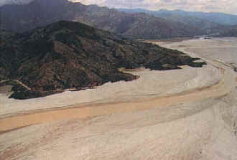

Slide 28
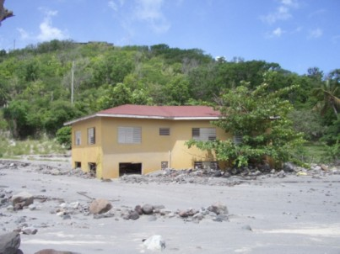

Slide 29
Volcanic Hazards
Acid Precipitation and Gasses
Sulfuric Acid – dissolves organic material
Hydrofluoric Acid – dissolves metal and glass
CO and CO₂ – choking gases (more dense than air so they push it out of the area as they are created)
SO₂ – colorless, odorless toxin that can be absorbed through the skin (attacks all major bodily systems)

Slide 30
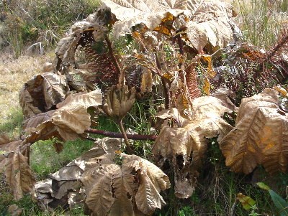

Slide 31
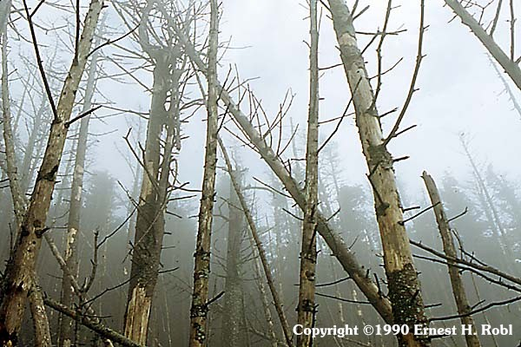

Slide 32
Benefits of Volcanoes
Fertile Soils
Nutrients and minerals in soil increased by volcanic activity
Geothermal Energy
Iceland generates a vast majority of their energy using the heat from volcanoes to generate electricity (extremely cheap)

Slide 33
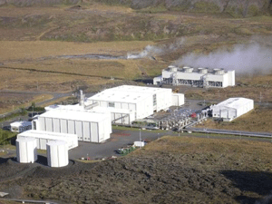

Slide 34
Classifying Volcanic Activity
Active – erupted in recent history
Dormant – erupted in the past several thousand years
Extinct – volcano has been eroded
(does not mean that it will never erupt again)

